Slide 1
VTT in POX
Sudha Chaurasia

Slide 2
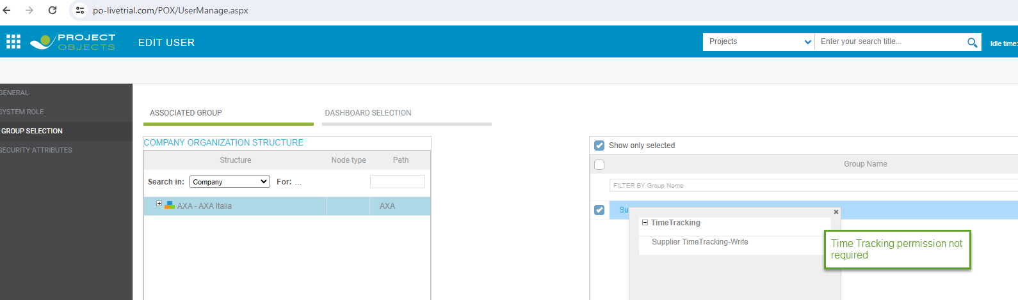
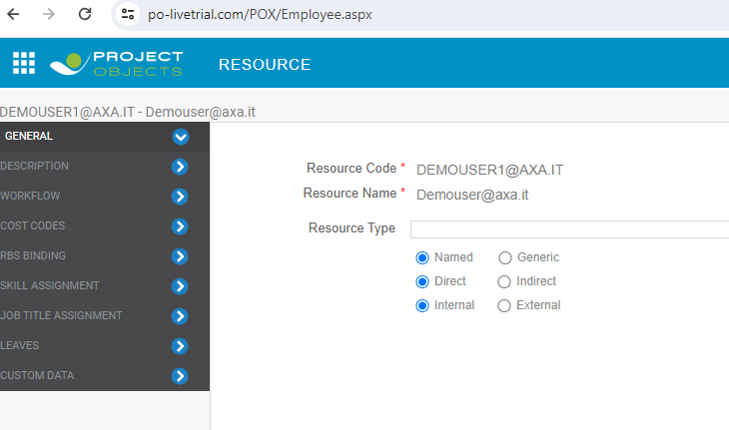
User minimum permission to access supplier register, resource Info

Slide 3
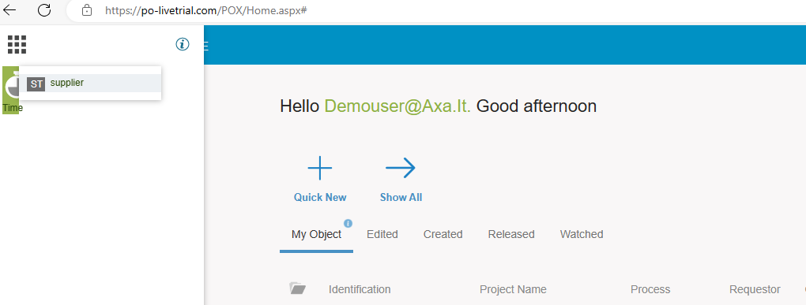
After Permission, the Supplier menu and register

Slide 4
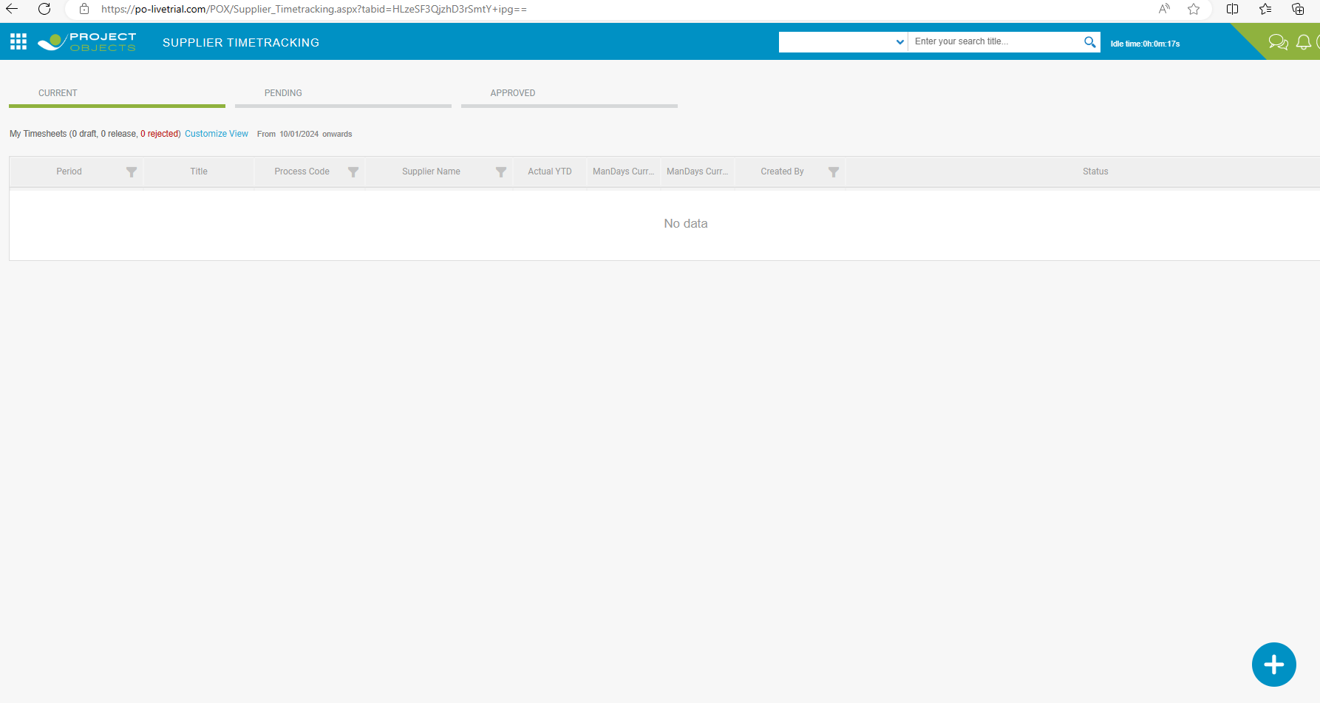
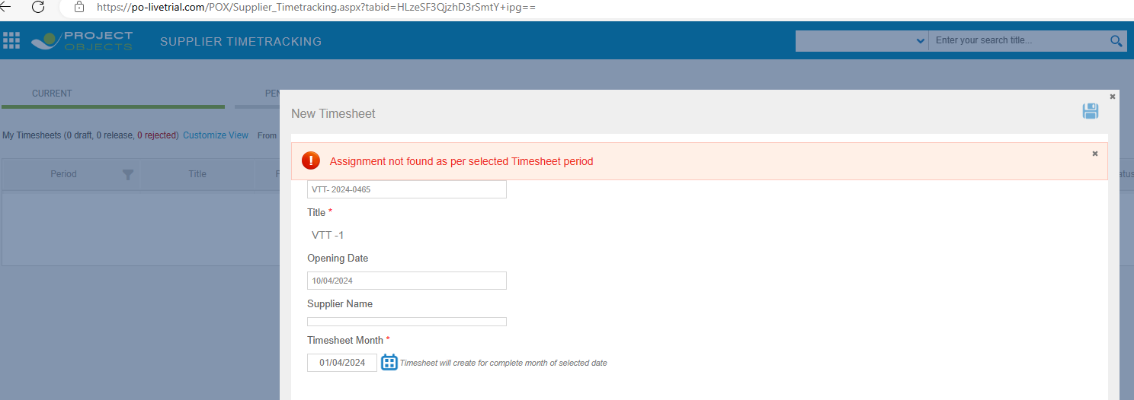
After Permission, the Supplier menu and register. Also + icon is there to create

Slide 5
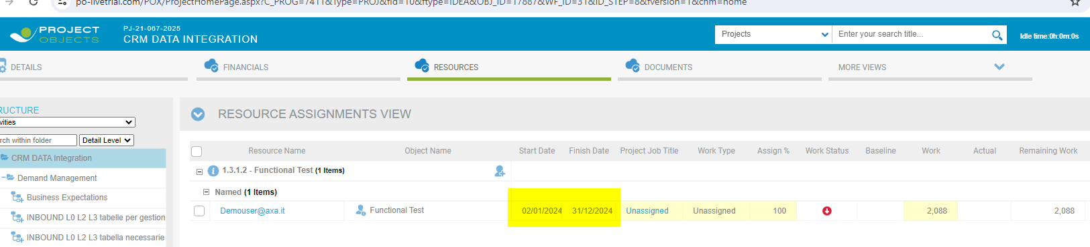
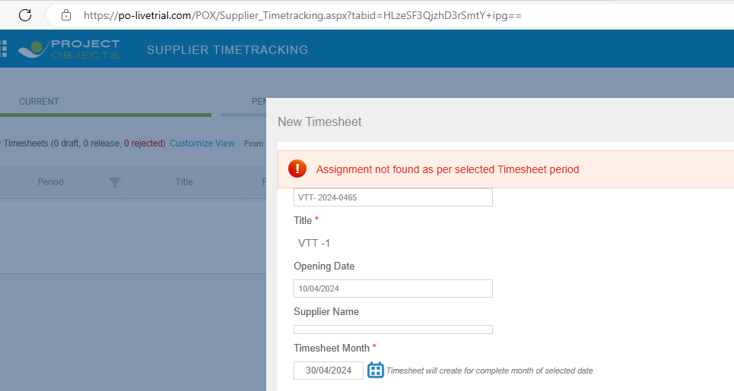
Since, system showing the validation of not assigning the resource, assign it over a task
Still the error is same, even resource assigned on a task in timesheet period

Slide 6
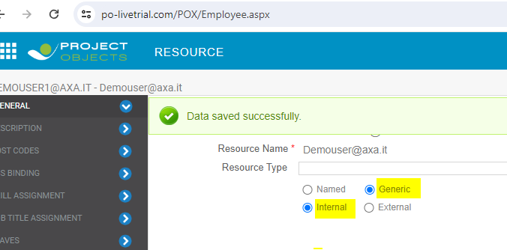
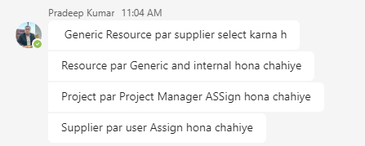
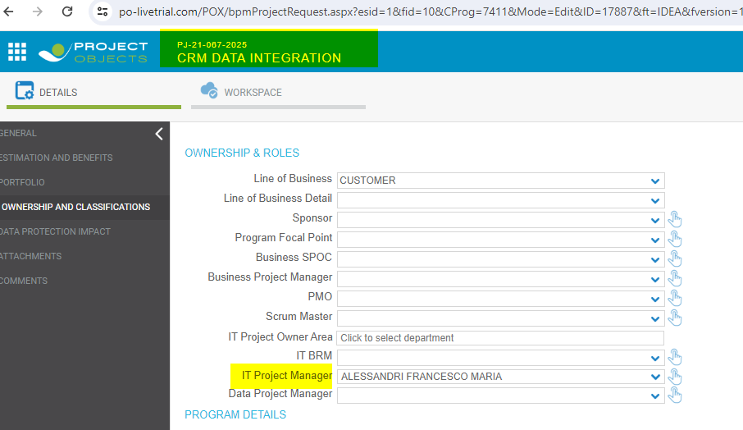
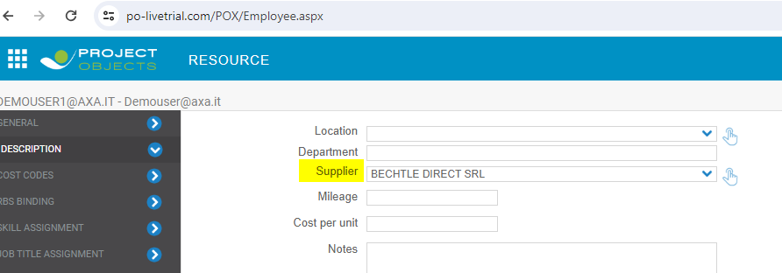
Do some required configuration of resource

Slide 7
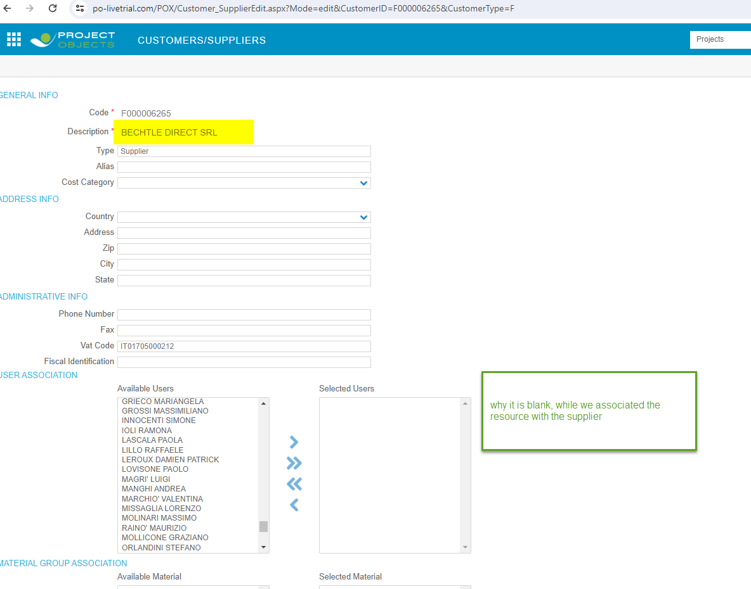
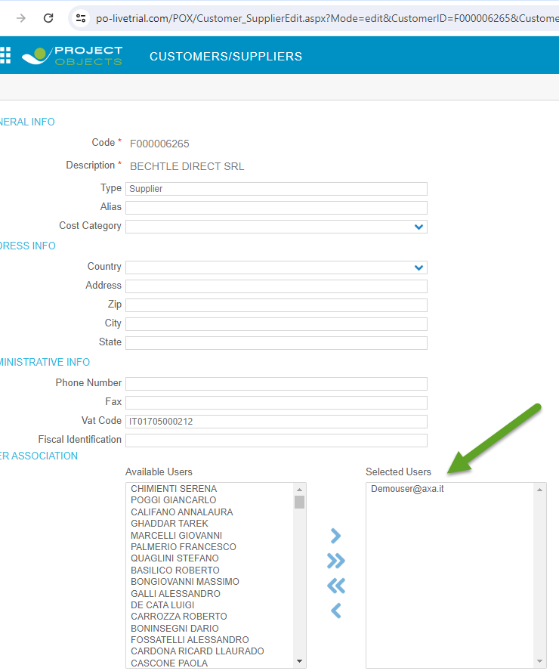
Do some required configuration of resource

Slide 8
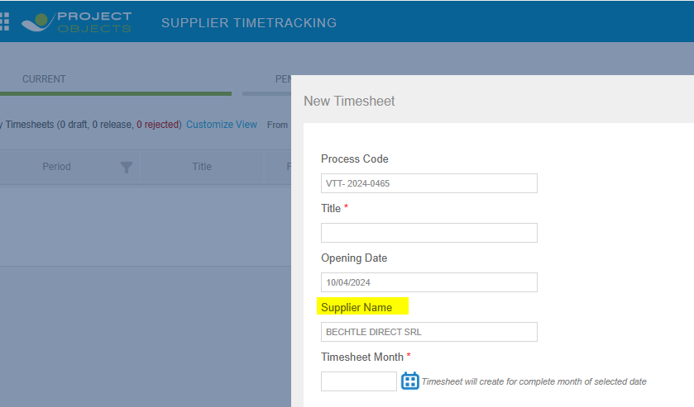
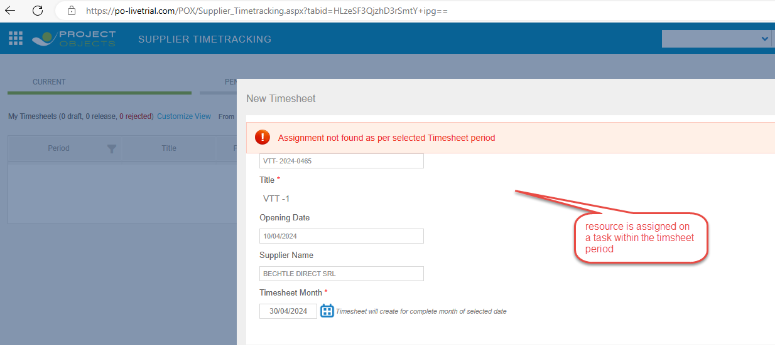
VTT after resource configuration, still the error is same.

Slide 9
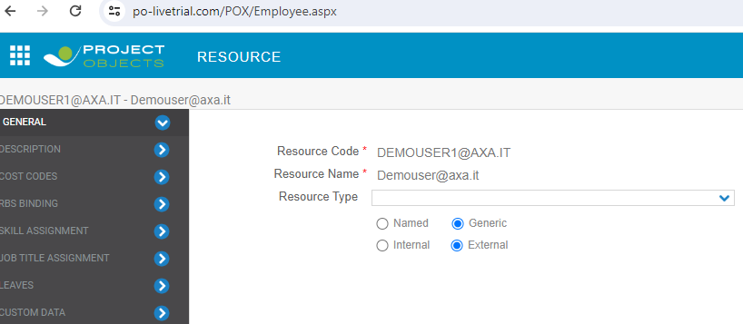
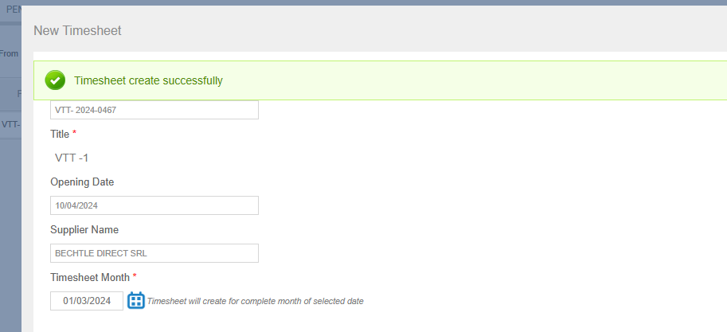
Again modify the configuration and set the resource as Generic + External. Now is created.

Slide 10
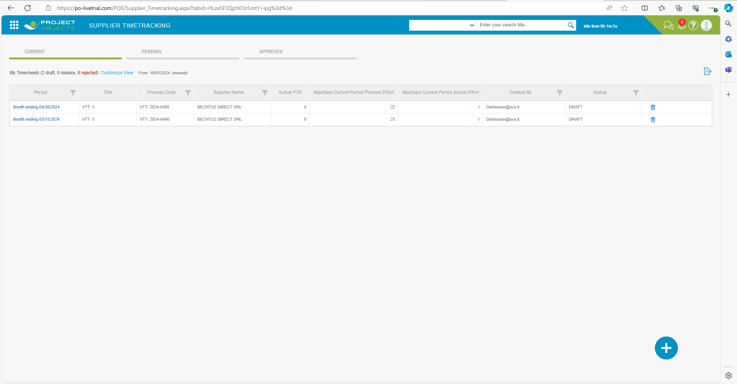
After VTT creation, register and page
Queries:
1- why there is filter on Supplier name ? Can resource associate with multiple supplier ?
2- Same for Status, over the current tab is it possible to show the other status timesheet ?
3- Is it possible anyway, that user can create timesheet for other resource ? 4- what is YTD ?

Slide 11
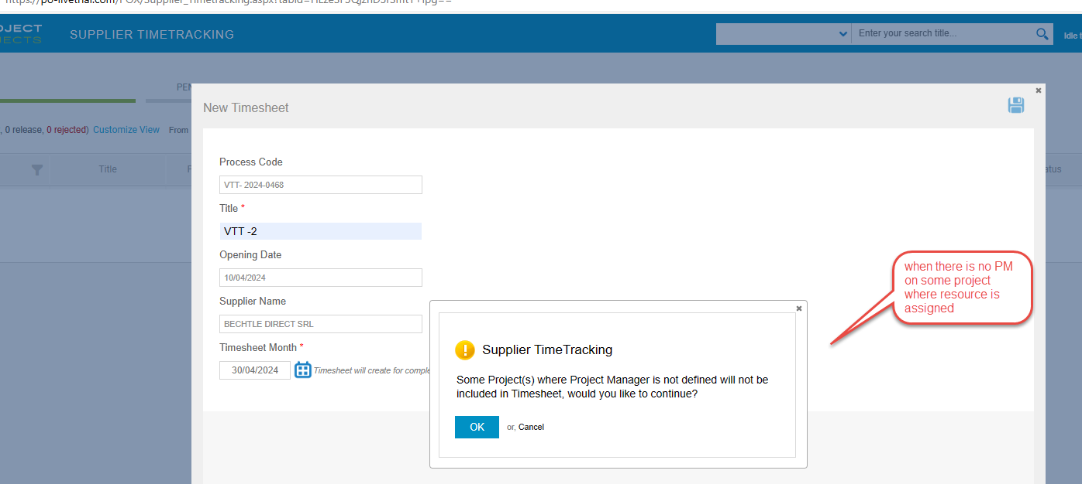
VTT creation – validation/informative messages

Slide 12
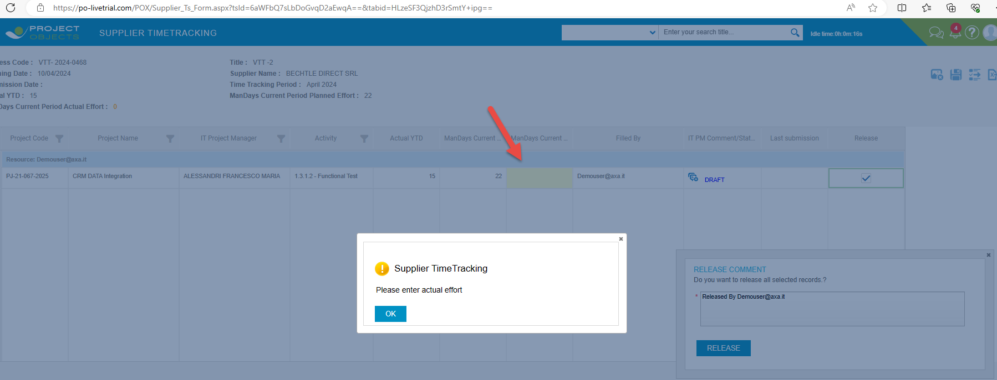
VTT creation

Slide 13
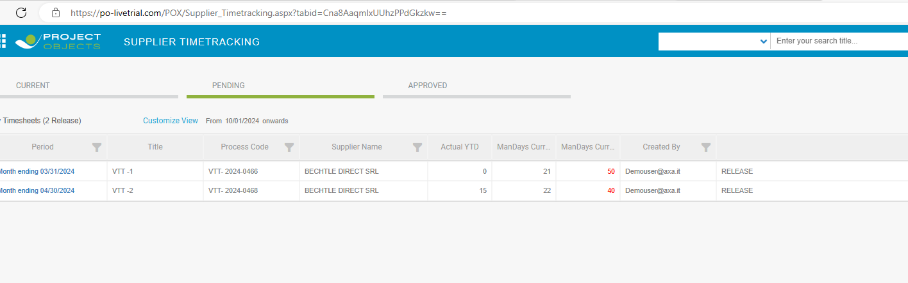
Pending timesheet – no information about who is the approver

Slide 14
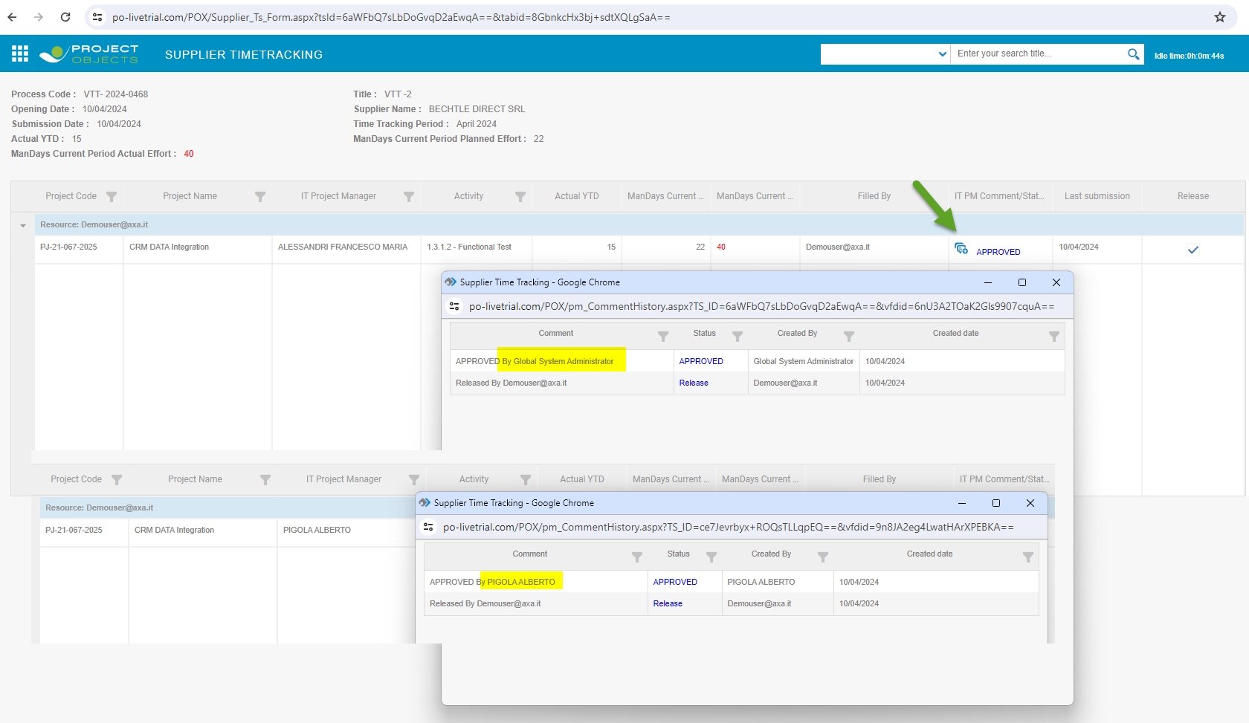
Approved timesheet

Slide 15
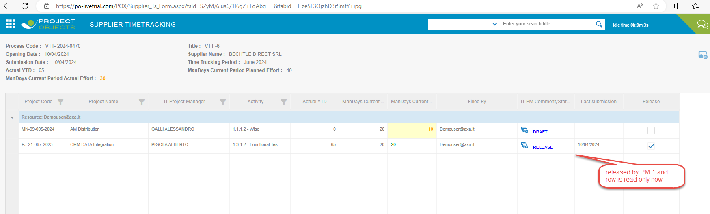
Supplier timesheet with multiple PM of each project

Slide 16
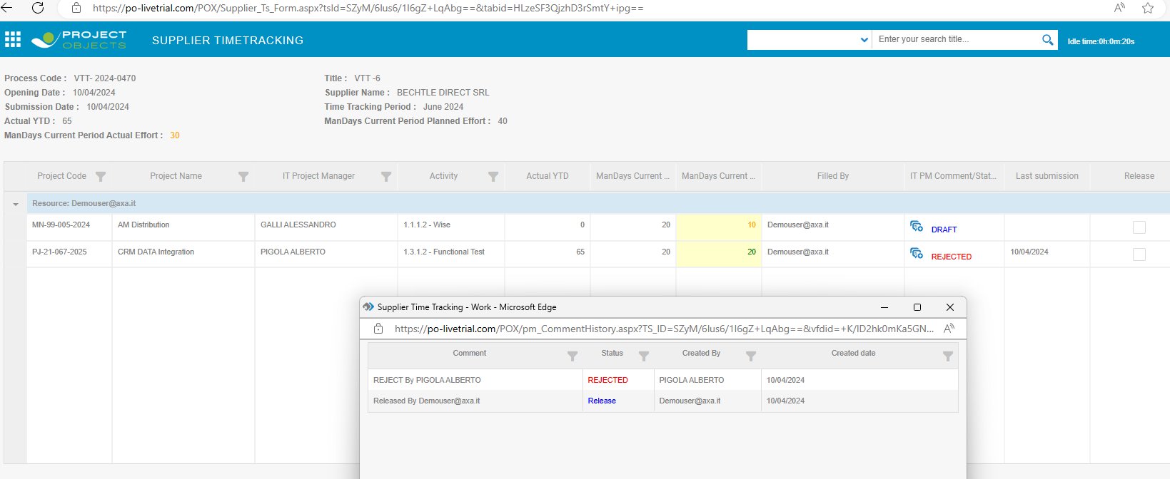
Supplier timesheet with multiple PM of each project – Reject case

Slide 17
Supplier timesheet with multiple PM of each project – Reject case
Query- After Supplier timesheet creation > the PM was removed from the project . Still timesheet get released. And there is no approver.
How the pending timesheets get approved in this case?

